Slide 3
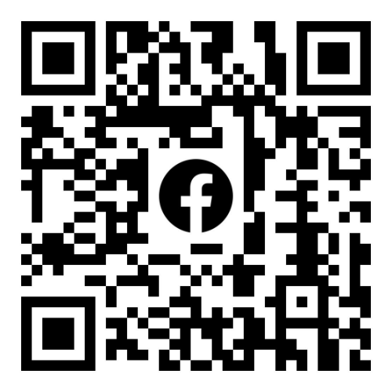
Join the
Flourish - CPKI Women
page on Facebook!
https://www.facebook.com/groups/1263309004767608

Slide 6
GCC Happenings

Slide 10
Pivot
Pastor Joy Briscoe

Slide 11
First
“Protect the Pivot”
Neh. 2:12 (NLT)
I slipped out during the night, taking only a few others with me. I had not told anyone about the plans God had put in my heart for Jerusalem. We took no pack animals with us except the donkey I was riding.

Slide 12
Criteria
-
Authority/Accountability
Confidant
Those in unity with you
17 But now I said to them, “You know very well what trouble we are in. Jerusalem lies in ruins, and its gates have been destroyed by fire. Let us rebuild the wall of Jerusalem and end this disgrace!”18 Then I told them about how the gracious hand of God had been on me, and about my conversation with the king.
Nehemiah 2:17-18 (NLT)

Slide 13
Nehemiah 2:17 (NLT)
17 But now I said to them, “You know very well what trouble we are in. Jerusalem lies in ruins, and its gates have been destroyed by fire. Let us rebuild the wall of Jerusalem and end this disgrace!”
Protect The Pivot

Slide 14
I WAS BORN FOR THIS!

Slide 15
Second
“Proceed in Your Promise & Purpose”
7 But when Sanballat and Tobiah and the Arabs, Ammonites, and Ashdodites heard that the work was going ahead and that the gaps in the wall of Jerusalem were being repaired, they were furious.
8 They all made plans to come and fight against Jerusalem and throw us into confusion.
Nehemiah 4:7-8 (NLT)

Slide 16
Nehemiah 4:1-3 (NLT)
1 Sanballat was very angry when he learned that we were rebuilding the wall. He flew into a rage and mocked the Jews,
2 saying in front of his friends and the Samarian army officers, “What does this bunch of poor, feeble Jews think they’re doing? Do they think they can build the wall in a single day by just offering a few sacrifices?[b] Do they actually think they can make something of stones from a rubbish heap—and charred ones at that?”
3 Tobiah the Ammonite, who was standing beside him, remarked, “That stone wall would collapse if even a fox walked along the top of it!”
Proceed in Your Promise & Purpose

Slide 17
Last
“Proper Plan”
Nehemiah 1:4 (NLT)
4 When I heard this, I sat down and wept. In fact, for days I mourned, fasted, and prayed to the God of heaven.

Slide 18
Nehemiah 2:4-5a (NLT)
4 The king asked, “Well, how can I help you?”
With a prayer to the God of heaven,
5 I replied, “If it please the king, and if you are pleased with me, your servant, send me to Judah to rebuild the city where my ancestors are buried.”

Slide 19
POWER IN THE PIVOT
What do you need
Closeout Question
Pastor Joy M. Briscoe

